Slide 1

Software Project Management Presentation
Enchanted
Movie
Presentation Contents —
Project Demo
Project Execution detail
Risk Plan
Test Plan
Lessons & Conclusion
Future Plan for next cycle
2023 June 1
- Team Members -
王思敏 202230310231 瞿茹芸 202230310215 许蒙蒙 202230310259

Slide 2
Project Executive detail
Enchanted Movie offers users a range of functions, including:
Sleek and user-friendly interface
Social features
Custom playlists
User reviews
Search function
Movie information
Review community
Movie ticketing
Daily recommendations
- Enchanted

Slide 3
Project Executive detail
Front-end : Design style & Philosophy
Inspiration | Drawing from the enchantment and mystique of the cinematic world, we encapsulate its rich diversity through color.
Color Palette | Indigo and pink are selected as primary colors, serving respectively as themes for light and dark modes based on user preference.
Icon Design | We chose Apple's SF Symbols for our icon design, ensuring consistency with the iOS platform and emphasizing our commitment to clean and efficient design principles.
Interface Design | UltraThinMaterial is deliberately selected as the primary style for its high transparency and ability to enhance the three-dimensional feel of the interface while providing users with a light and premium visual experience.
Design Philosophy | Our design philosophy focuses on finding the perfect balance between elegance and simplicity. We aim to evoke the magical feelings associated with cinema while also delivering a smooth and intuitive user experience through the design of "Enchanted Movie".
- Enchanted

Slide 4
Project Executive detail
Front-end : Key SwiftUI Components & Techniques
Navigation Management | NavigationView and NavigationViewLink are utilized for the management of the application's navigation.
Displaying Movie Lists | We employ List and ForEach components to display the movie lists, with each entry structured using HStack.
Content within Each Entry | Each entry contains elements such as the movie cover, title, and ratings.
Detail Page Layout Design | ScrollView and VStack are used to design the layout of the detail page.
State Management | The state of the application is managed through @State and @Binding.
Handling Network Requests | Network requests are handled with Combine and URLSession to retrieve movie data from the server
- Enchanted

Slide 5
Project Executive detail
Front-end : Interaction Design
Intuitive Navigation System | Designed to facilitate seamless movement between different parts of the application.
Practical Search Feature | Implemented to help users quickly find their desired movies.
Personalized Options | Users can favorite and share movies, allowing them to engage with content in a way that suits their preferences.
Support for Dark and Light Themes | The app adjusts to the system's default Dark and Light themes, catering to users' varying visual needs in different environments.
- Enchanted

Slide 6
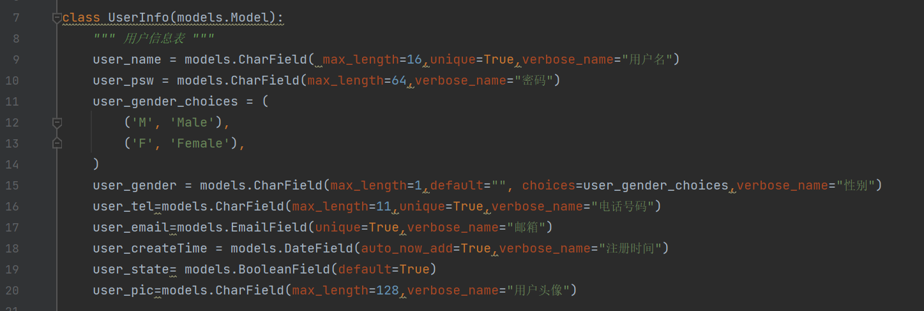
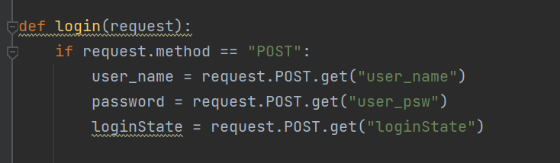
Project Executive detail
Realization of System Function Modules
Function Module : user Login and Registration
User Info
field name | field meaning | field requirements
user_id | user ID | char(11)
user_name | user name | nvarchar(16)
user_psw | user password | nvarchar(64)
user_gender | user gender | char(1)
user_tel | User telephone number | char(11)
user_email | user e-mail | nvarchar(50)
user_createTime | User registration time | datetime(10)
user_state | user status | nvarchar(10)
user_pic | profile picture | char(128)
URL | view | illustrate
/users/register/ | views.register | register
/users/login/ | views.login | Log in
/users/logout/ | views.logout | Sign out
/users/userInfo/ | views.userInfo | user personal information
- Enchanted

Slide 7
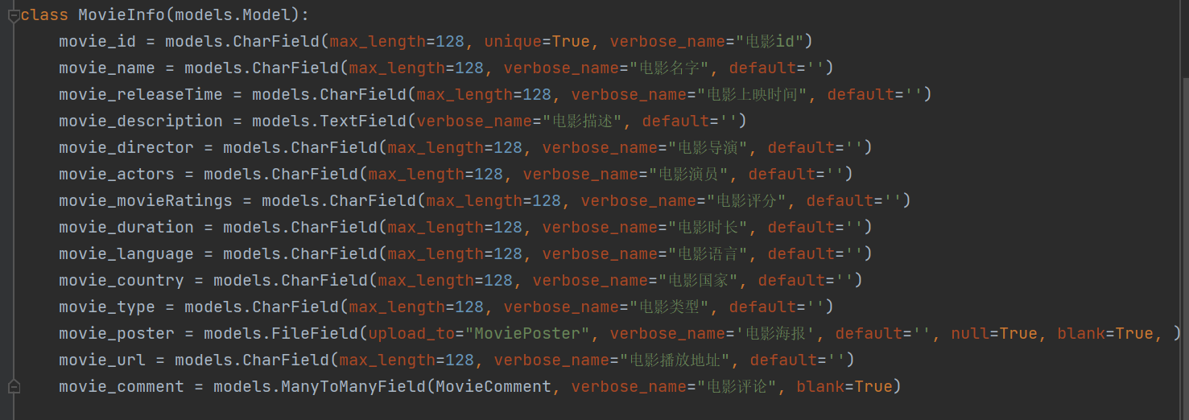
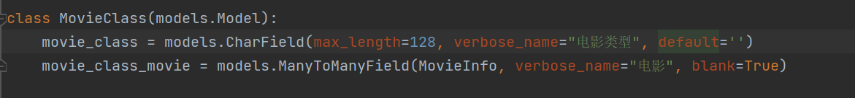
Project Executive detail
Realization of System Function Modules
Function Module : Movie Information
Movie Info
field name | field meaning | field requirements
movie_id | movie number | char(11)
movie_name | movie title | nvarchar(100)
movie_ releaseTime | movie showtime | datetime (10 )
movie_description | movie description | nvarchar(1024)
movie_director | Movie director | nvarchar(64)
movie_actors | Movie actor | nvarchar(64)
movie_ movieRatings | movie rating | nvarchar(10)
movie_duration | movie duration | nvarchar(11)
movie_language | movie language | nvarchar(128)
movie_country | movie country | nvarchar(128)
movie_type | movie type | MoviePoster
movie_poster | movie poster | char(128)
movie_url | movie playback address | char(128)
movie_comment | movie review | Movie Comment
Movie Class
- Enchanted
field name | field meaning | field requirements
movie_class | movie class | char(11)
movie_class_movie | movie class movie | Movie Info

Slide 8
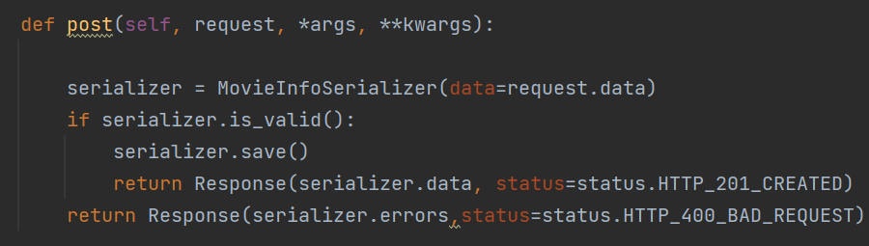
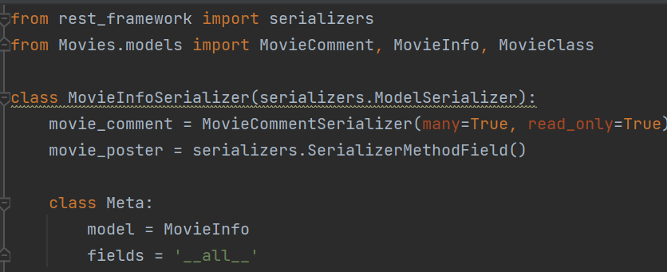
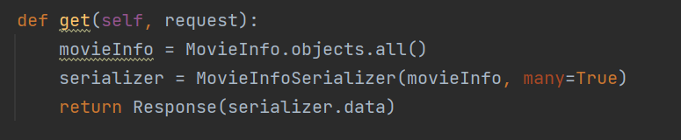
Project Executive detail
Realization of System Function Modules
Function Module : Movie Information
URL | view | illustrate
/Movies/MovieInfo/ | views.MovieInfoView | Provide movie information data for the front end
Data Validation
module serialization
Use Django Rest Framework
get request processing
- Enchanted

Slide 9
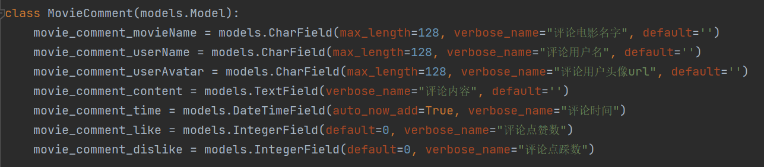
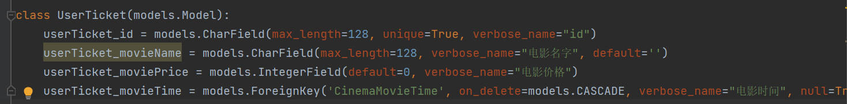
Project Executive detail
Realization of System Function Modules
Function Module : Movie Review
Function Module : Movie Ticketing
Movie comment
User Ticket
field name | field meaning | field requirements
movie_comment_movieName | Reviews of movie name | char(128)
movie_comment_userName | Comment of username | char(128)
movie_comment_userAvatar | Reviews of userAvatar | char(128)
movie_comment_content | comments | char(128)
movie_comment_time | comment time | datetime (10 )
movie_comment_like | Comment likes | none
movie_comment_dislike | Comments dislikes | none
field name | field meaning | field requirements
userTicket_id | Ticket information number | char(11)
userTicket_movieName | movie name | nvarchar(100)
userTicket_moviePrice | movie price | d ecimal( 10)
userTicket_movieTime | movie showtime | datetime (10 )
- Enchanted

Slide 10
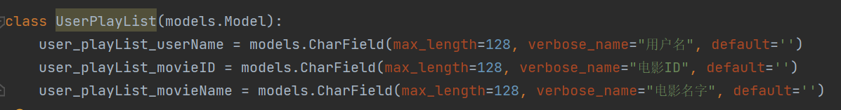
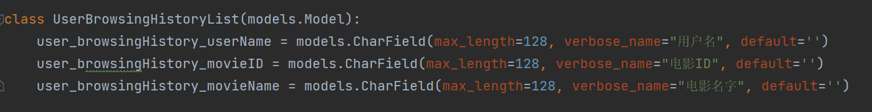
Project Executive detail
Realization of System Function Modules
Function Module : Custom Playlists
Function Module : Custom Browsing History
User Play List
User Browsing History List
field name | field meaning | field requirements
user_playList_userName | username | char(11)
user_playList_movieID | movie number | char(11)
user_playList_movieName | movie name | nvarchar(100)
field name | field meaning | field requirements
user_browsingHistory_userName | username | char(11)
user_browsingHistory_movieID | movie number | char(11)
user_browsingHistory_movieName | movie name | nvarchar(100)
- Enchanted

Slide 11
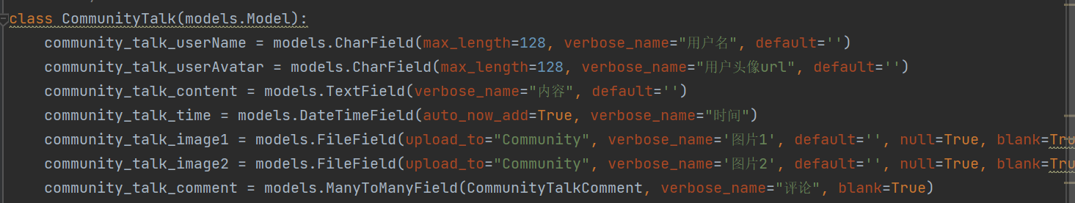
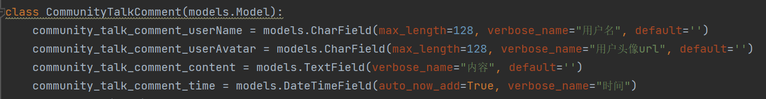
Project Executive detail
Realization of System Function Modules
Function Module 9 : Social Function —— Movie community
Community Talk
Community Talk Comment
field name | field meaning | field requirements
community_talk_userName | username | char(11)
community_talk_userAvatar | user avatar url | nvarchar(128)
community_talk_content | content | nvarchar(100)
community_talk_time | time | datetime(10)
community_talk_image1 | Picture 1 | char(128)
community_talk_image2 | picture 2 | char(128)
community_talk_comment | Comment | CommunityTalkComment
field name | field meaning | field requirements
community_talk_comment_userName | username | char(11)
community_talk_comment_userAvatar | user avatar url | nvarchar(128)
community_talk_comment_content | content | nvarchar(100)
community_talk_comment_time | time | datetime(10)
- Enchanted

Slide 12
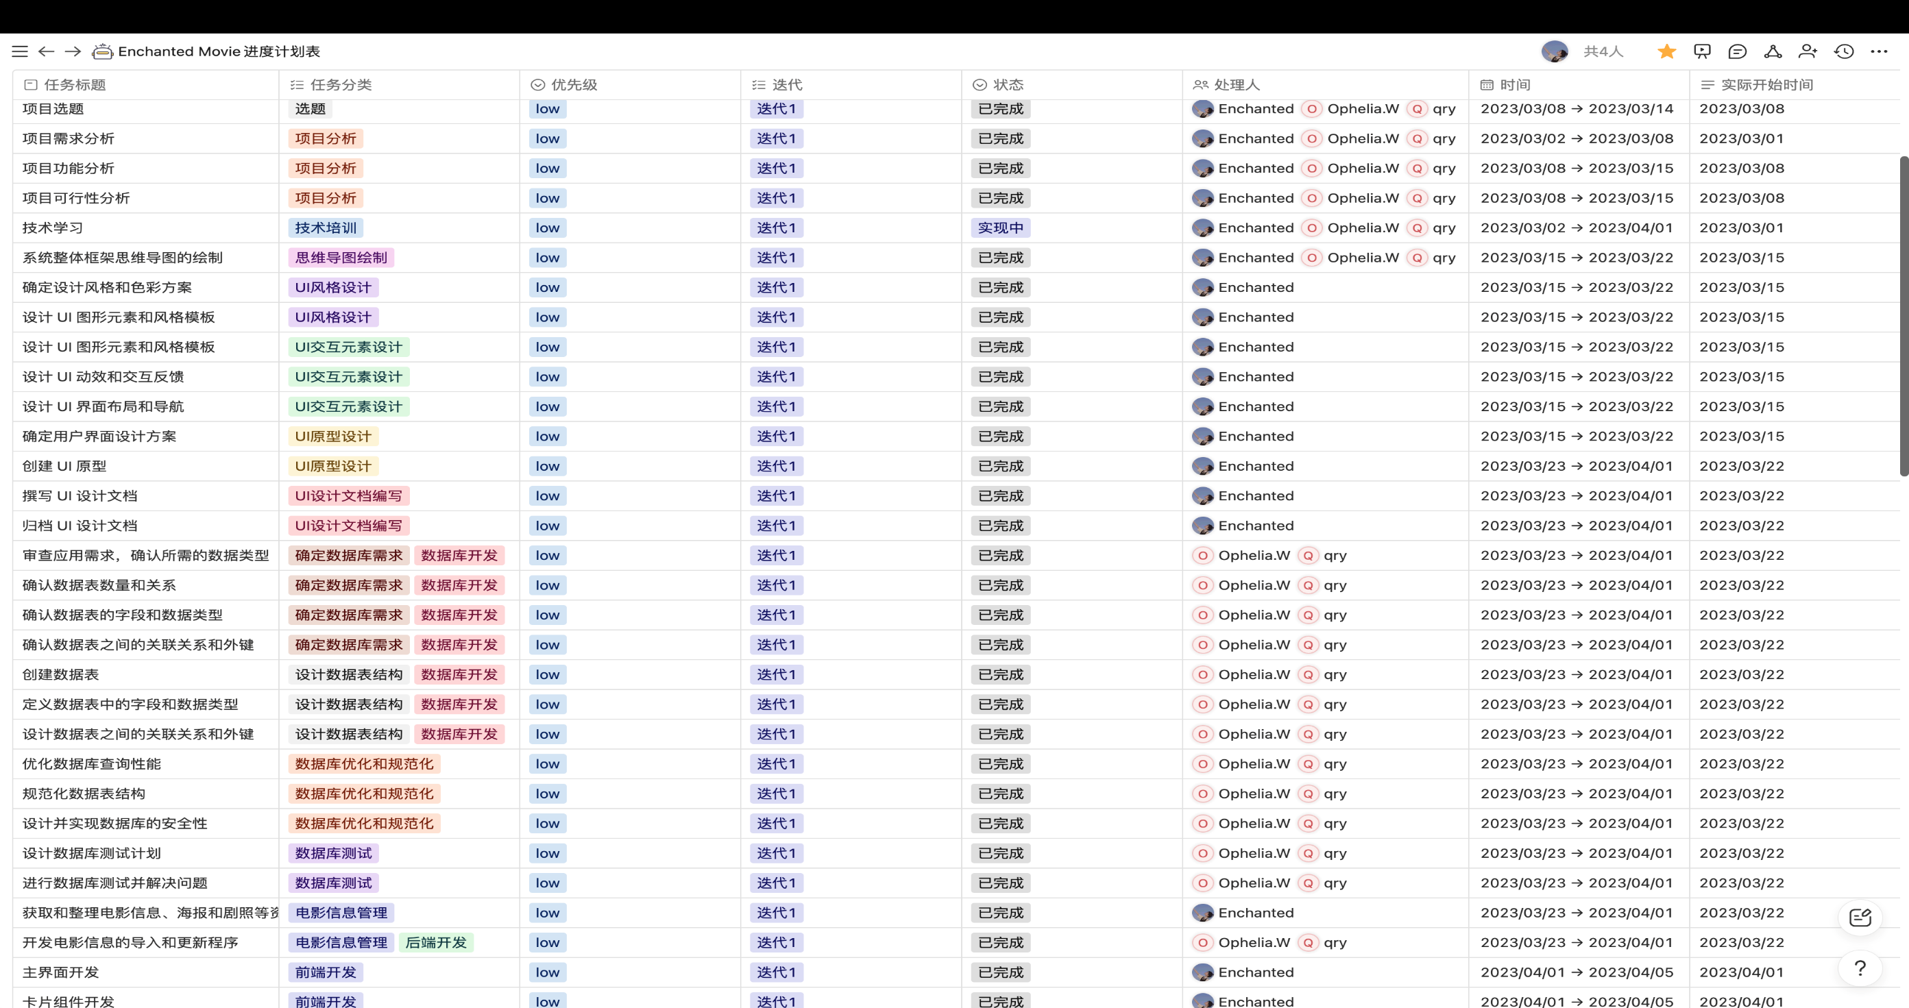
Project Executive detail
- Enchanted

Slide 13
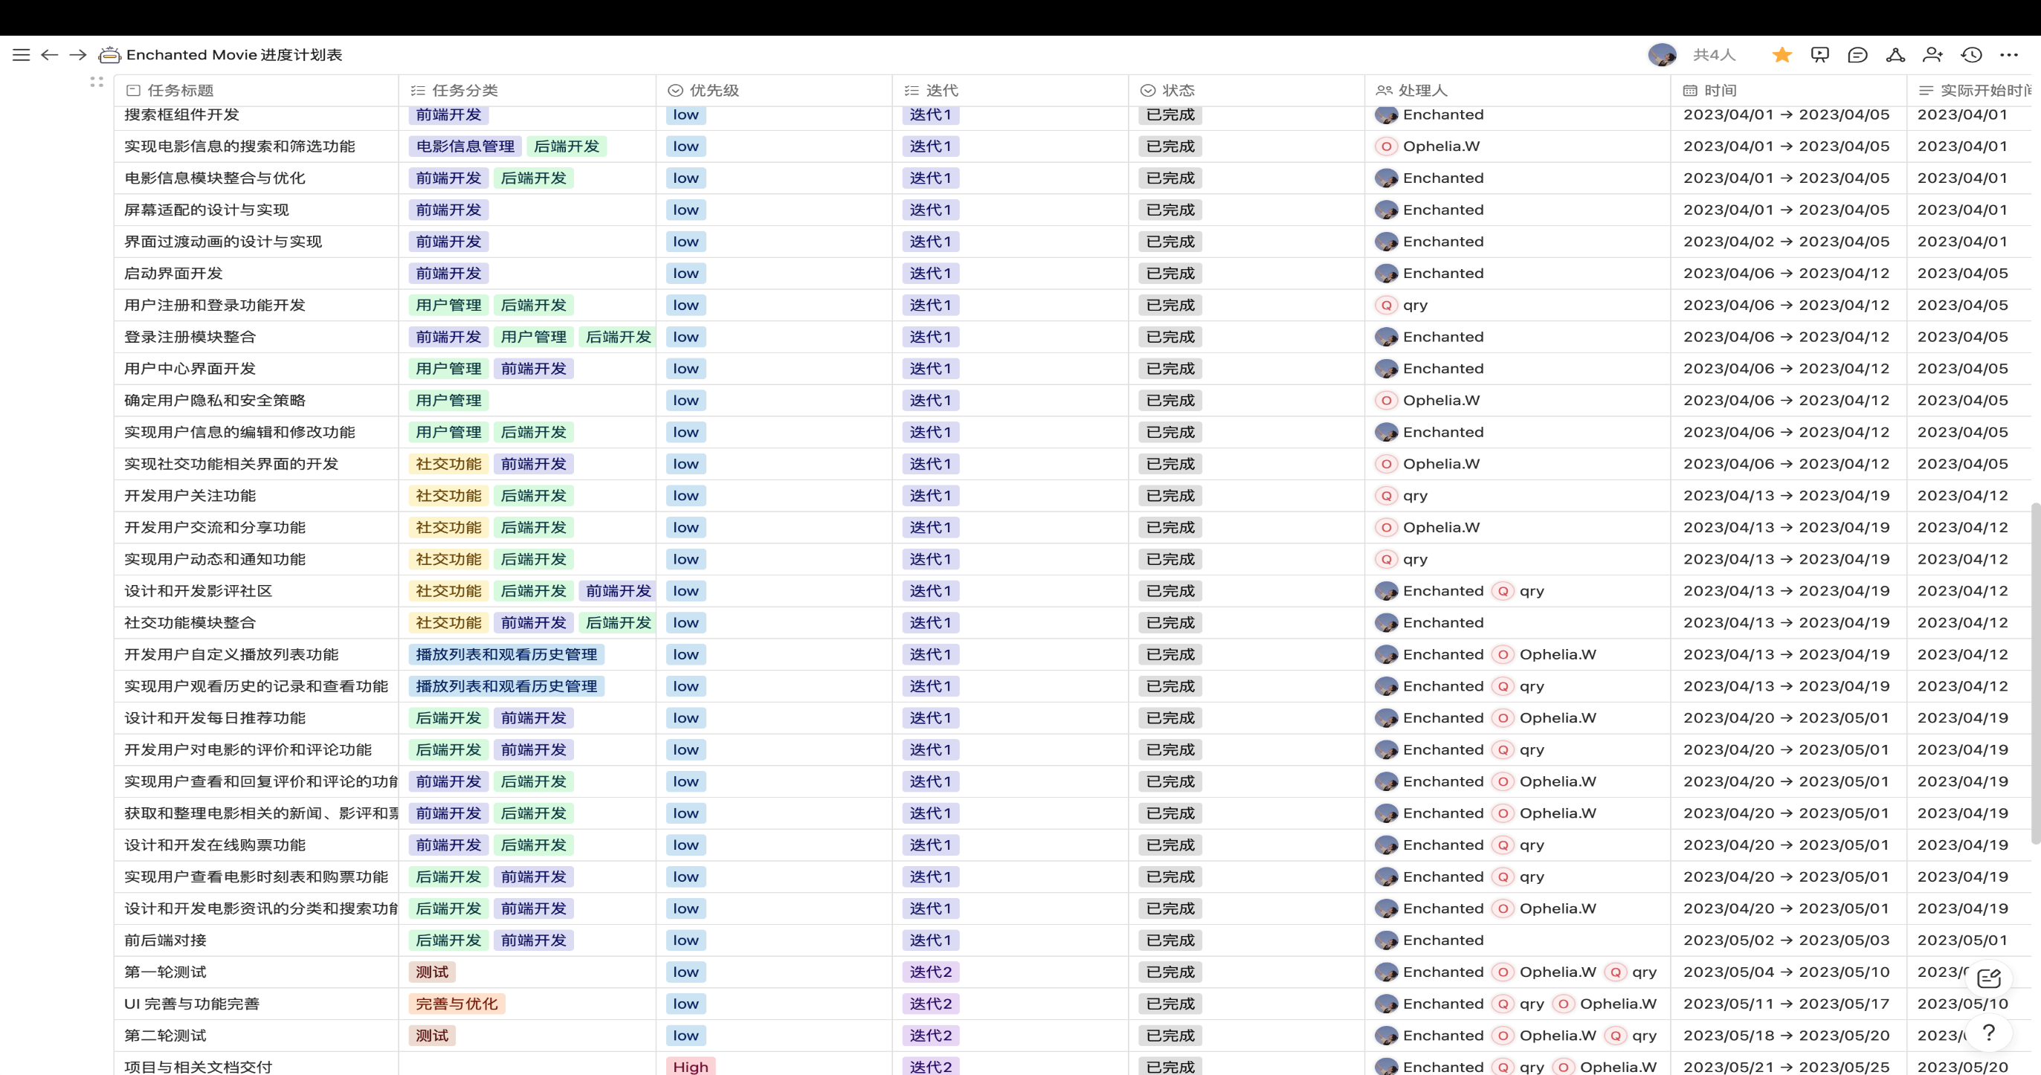
Project Executive detail
- Enchanted

Slide 14
Risk Management Plan
Risk Category | Probability | Impact | Risk Description | Preventive Measures | Corrective Measures
Requirements Analysis | Medium | Medium | A core team member may temporarily leave the project due to health reasons. | Establish a multi-level team cross-training mechanism to ensure that multiple team members can take over the core member's responsibilities. | Prepare backup personnel for the core member to ensure that core functions can continue when necessary.
Framework Design | High | High | The development team may encounter technical difficulties due to the use of new technology. | Establish a technical group including external team members to be able to solve problems quickly when they arise. | Regularly schedule technical reviews to ensure the project is on schedule, and adjust technical solutions if necessary.
UI Design | High | High | The project may face delays due to personnel changes or technological reasons. | Establish an executable timetable so that everyone knows the deadline for their tasks. | Regularly evaluate progress and find solutions to ensure that the project can proceed as planned.
Software Functionality Development | Medium | High | Frequent changes in requirements may result in project delays or exceed budgets. | Develop a clear requirement change process, clarify the person responsible for the change, and ensure that each change is sufficiently approved and evaluated. | Review changes to avoid unnecessary changes, and timely incorporate necessary changes into the project management plan, and conduct sufficient communication and coordination to avoid unnecessary delays and additional costs.
Software Functionality Testing | Low | Low | The project may face financial problems due to insufficient funds or budget overruns. | Regularly monitor the budget and seek ways to reduce costs. | Regularly conduct budget reviews and take corrective action when necessary.
Classroom Demonstrations | Low | High | In the project management process, improper management decisions or lack of resources, communication, and leadership abilities may lead to project progress being blocked or major errors occurring. This may ultimately result in project delays, cost overruns, or quality issues, leading to project failure. | Provide sufficient resources and power for the project manager to effectively manage and control project progress, cost, and quality; establish effective communication mechanisms and processes to ensure smooth communication between project team members. | Strengthen communication and coordination in the event of management errors; seek support and solutions in the event of resource shortages; adjust plans and resources promptly to ensure project progress and completion quality in the event of schedule delays.
- Enchanted

Slide 15
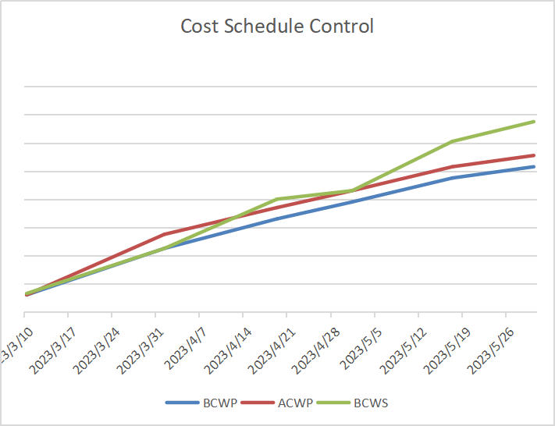
Risk Plan
Risk Analysis
- Enchanted

Slide 16
Test Plan
Wang simin
- Enchanted Movie -

Slide 17
Test Plan
Test Schedule
Testing Activities | Planned Start Date | Actual Start Date | End Date
Develop Test Plan | 2023-5-4 | 2023-5-4 | 2023-5-5
Design Testing | 2023-5-5 | 2023-5-6 | 2023-5-10
Interface Testing | 2023-5-9 | 2023-5-10 | 2023-5-19
System Testing | 2023-5-18 | 2023-5-20 | 2023-5-21
Performance testing | 2023-5-20 | 2023-5-21 | 2023-5-22
Evaluation of tests | 2023-5-23 | 2023-5-23 | 2023-5-24
Product release | 2023-5-25 | 2023-5-25 | 2023-5-25
- Enchanted

Slide 18
Test Plan
Staffing Schedule
Role | Staff | Responsibility
Test Manager Test Design Tester | Wang Simin | Provide management supervision. Identify test cases, prioritize test cases and implement test cases. Execute tests.
Test System Administrator Database Administrator Database Designer | Qu Ruyun | Ensure test environment and assets are managed and maintained Ensure that the test data (database) environment and assets are managed and maintained Identify and define operations, attributes and associations for test classes
Database Implementer | Xu Mengmeng | Implement test classes and test packages and perform unit tests on them
- Enchanted

Slide 19
Test Plan
Test Environment
software environment:
The system is tested using black-box testing methods in the environments of Windows 10 and macOS Ventura, utilizing automated testing tools.
hardware environment:
system | processor | internal storage
Windows 10 Home Chinese version | 2.80 GHz | 16.0 GB
Windows10 Home Chinese version | 2.90GHz | 8.00GB
macOS Ventura 13.3.1 | Apple M1Max | 32GB
- Enchanted

Slide 20
Interface test——Registration
Test Plan
Field name | description
Test items | Registration function
Test environment requirements | You can connect to the server normally Software: IE 7.0 browser and above
test method | Unit testing was performed using an automated test framework
Enter the instructions | Send a POST request with the following parameters: User _ name: The user name of the registered user User _ password: The password of the registered user
Output standard | Verify that the HTTP response status code is 200 Verify that the response meets expectations
number | test case | input | expected result
1 | The test login was successful | Enter the correct user name, password, and login status. | The response status code is 200, and the response content contains the "login success" prompt message
2 | Test password error | Enter the correct user name, but the incorrect password and login status | The response status code is 200, and the response content contains the "User Password Error" prompt message.
3 | Test user does not exist | Enter a non-existing user name, arbitrary password, and login status | The response status code is 200, and the response content contains the "User Account does not exist" prompt message.
- Enchanted

Slide 21
Interface test——Login
Test Plan
Field name | description
Test items | Login function
Test environment requirements | You can connect to the server normally Software: IE 7.0 browser and above
test method | Unit testing was performed using an automated test framework
Enter the instructions | Send a POST request with the following parameters: User _ name: The user name of the test user User _ password: Test the user's password User _ loginState: Test the login status of the user
Output standard | Verify that the HTTP response status code is 200 Verify that the response content contains the expected prompt message
number | test case | input | expected result
1 | The test login was successful | Enter the correct user name, password, and login status. | The response status code is 200, and the response content contains the "login success" prompt message
2 | Test password error | Enter the correct user name, but the incorrect password and login status | The response status code is 200, and the response content contains the "User Password Error" prompt message.
3 | Test user does not exist | Enter a non-existing user name, arbitrary password, and login status | The response status code is 200, and the response content contains the "User Account does not exist" prompt message.
- Enchanted

Slide 22
Interface test——Movie ticketing
Test Plan
Field name | description
Test items | Movie ticketing function
Test environment requirements | You can connect to the server normally Software: IE 7.0 browser and above
test method | Unit testing was performed using an automated test framework
Enter the instructions | Provide a valid movie ID and the ticket purchase amount;
Output standard | The status codes and response data were returned as expected
number | test case | input | expected result
1 | Test of the successful purchase of movie tickets | Valid movie ID and ticket purchase amount | Return status code 201; the response data contains the movie ticket ID, price, and movie information
2 | Test for the case of purchasing a non-existent movie ID | Nonexistent movie ID | Return status code 400; response data contains error message "Invalid movie ID"
3 | Test the shortage of movie tickets purchased | The ticket purchase amount is lower than the movie ticket price | Return status code 400; response data contains error message "Insufficient funds"
- Enchanted

Slide 23
Interface test——Adding movie reviews
Test Plan
Field name | description
Test items | Adding movie reviews
Test environment requirements | You can connect to the server normally Software: IE 7.0 browser and above
test method | Unit testing was performed using an automated test framework
Enter the instructions | Movie ID, review user information, review content
Output standard | Successfully added comment, return status code 200, return value of "1"; Add comment failed, return status code 200 with return value "0"
number | test case | input | expected result
1 | Add comments normally | Movie ID, review user information, review content | Successfully added successfully returned status code 200 with return value "1"
2 | Missing information when adding comments | Movie ID, lack of review user information or comment content | Add comment failed, return status code 200 with return value "0"
3 | Invalid movie ID | Invalid movie ID, comment on the user information, comment on the content | Add comment failed, return status code 200 with return value "0"
4 | Server connection was abnormal | Movie ID, comment user information, comment content, cannot be connected to the server | Add comment failed, returned status code 500 or failed to connect to the server error message
5 | Enter a comment with an illegal character | Movie ID, review user information, comments containing illegal characters | Add comment failed, return status code 200 with return value "0"
- Enchanted

Slide 24
Test Plan Risk List
Test Plan
Number | Risk description | Solutions
1 | Demand analysis is not comprehensive | Evaluate uncompleted functions and consider waiver in terms of importance and time permit
2 | The development cannot be completed on schedule | Track the development progress and adjust the test schedule in time
3 | Leave for illness or other reasons | Training, increase manpower
4 | Module function change | Actively communicate with the developers and re-assign the test tasks
5 | The test environment is not synchronized with the development environment | Strengthen the version management, implement the database version management, and update the test data regularly
6 | The new start time | Strengthen the training of new recruits in the early stage of the project, and the testers will be familiar with the products as soon as possible
7 | The testers did not communicate enough with the relevant developers | By establishing software test record report and software test report system, and personal weekly report system, make full use of Github, manage the assessment of software system and software test manager.
8 | Testing cannot be performed as planned due to delays in developer releases, resulting in inadequate testing | Cooperate with the development schedule to make the corresponding overtime work.
- Enchanted

Slide 25
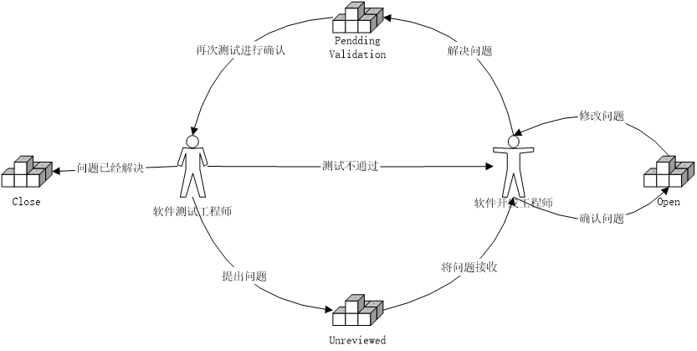
Test Plan
Defect Report Handling Process
Defect Report
test items | Test category | test method | test data | whack | error state
Test exit function | function testing | black-box testing | user_name: "TestUser" user_loginState: "inactive" | The response status code is 200 The response content is "Logout success" | The field value used in the query condition does not match the record in the database
- Enchanted

Slide 26
Lessons learnt
I learned in depth about the software project lifecycle and the tasks and requirements of each phase.
Requirements Analysis Phase : I learned to effectively communicate with the team member to understand expectations and needs and translate them into clear project specifications.
Planning Phase : I learned how to develop a project plan, determine the scope, time and resources of the project, and set reasonable milestones and delivery dates.
Development Phase : I used several techniques such as Django framework to build my app. Django provides a powerful and flexible set of tools and features that make the development process more efficient and streamlined.
Testing phase : I learned about different types of testing methods, including unit testing, integration testing, and system testing. I learned to write test cases and use automated testing tools to ensure that my App works properly and has good stability and reliability under various situations.
Deployment Phase : I learned how to deploy my App to the server so that users can access and use it. I learned about different deployment options and configurations, including server environment setup, database setup, and domain binding.
- Enchanted Movie -

Slide 27
Conclusion
In the Software Project Management course, I learned how to effectively plan, execute, and control software projects.
The importance of the different phases of requirements analysis, planning, design, development, testing and deployment, and mastered the best practices and methods for each phase.
The importance of teamwork, such as assigning tasks appropriately, tracking progress, solving problems and promoting good communication, are all key factors in the successful completion of a project.
Learn to be flexible and adjust in a timely manner when challenges and difficulties are encountered in a project, such as changes in requirements, resource constraints and time pressures, to resolve these issues and make the project progress smoothly.
In the development phase of the project, learn to use Django for model design, view function writing, URL configuration, template rendering, and database operations to improve technically.
The importance of software project management goes beyond the development technology itself. Understanding and mastering the knowledge and skills of project management can help improve the efficiency of the team, ensure the quality and successful delivery of the project
- Enchanted Movie -

Slide 28
Future Plan
Future plan for next cycle
Looking ahead, we have several exciting plans to enhance and expand Enchanted Movie in order to provide an even more immersive and comprehensive movie experience for our users. Here are some of our future plans:
Enhanced personalization: We aim to further personalize the user experience by leveraging advanced algorithms and user preferences.
Seamless integration with streaming platforms: We are actively working on partnerships and integrations with popular streaming platforms to allow users to directly access and stream movies from within the Enchanted Movie app.
Exclusive content and partnerships: We plan to collaborate with movie studios, distributors, and content creators to bring exclusive content and special promotions to our users.
Social engagement and community expansion: We will continue to foster a vibrant and engaged community within Enchanted Movie. This includes expanding our social features, such as discussion forums, live chats, and interactive events, where users can connect, share their passion for movies, and exchange recommendations and opinions.
International expansion: We have plans to expand Enchanted Movie's availability to a broader global audience. This will involve localizing the app in different languages, curating content specific to different regions, and partnering with local movie theaters and ticketing services to provide a comprehensive movie experience worldwide.
Continuous improvement and bug fixes: We are committed to constantly improving Enchanted Movie based on user feedback and suggestions. We will diligently add
- Enchanted

Slide 29
Thanks
- Enchanted Movie -

